Slide 1

Recurrent Neural Networks for time series
Notes:
1

Slide 2
Objectives
Conceptual overview Recurrent Neural Networks for time series
Implement a Simple RNN for forecasting
Recurrent Neural Networks for time series
2

Slide 3
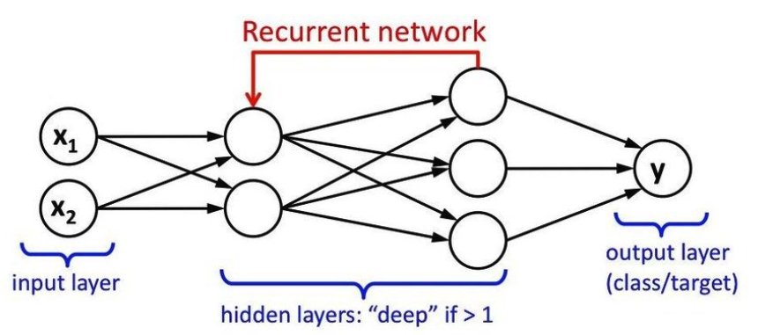
Recurrent Neural Networks
Recurrent Neural Networks (RNNs) are a type of artificial neural network designed for sequence modeling and processing.
RNNs have connections that form directed cycles, allowing them to maintain a memory of previous inputs in their internal state.
Recurrent Neural Networks for time series
3
Notes:
3

Slide 4
Features of RNN
Recurrent Connections:
RNNs have connections that loop back on themselves, enabling them to maintain a hidden state that captures information about previous inputs in a sequence.
Sequential Processing:
RNNs process inputs sequentially, taking into account the order of the elements in a sequence. Each step in the sequence influences the network's state and output.
Recurrent Neural Networks for time series
4
Notes:
4

Slide 5
Features of RNN
Shared Weights:
The same set of weights and biases is used at each time step, allowing the network to learn patterns and dependencies across different positions in the sequence.
Variable-Length Sequences:
RNNs can handle sequences of varying lengths, making them flexible for tasks where the length of the input or output sequence is not fixed.
Recurrent Neural Networks for time series
5
Notes:
5

Slide 6
Features of RNN
Vanishing and Exploding Gradients:
RNNs are prone to issues like vanishing and exploding gradients, which can make it challenging to capture long-range dependencies in sequences. This limitation has led to the development of more advanced RNN architectures.
Long Short-Term Memory (LSTM) Networks:
LSTMs are a specialized type of RNN designed to address the vanishing gradient problem. They introduce memory cells and gating mechanisms to better capture and control long-term dependencies.
Recurrent Neural Networks for time series
6
Notes:
6

Slide 7
Applications of RNN:
Natural Language Processing (NLP):
RNNs are widely used for tasks such as language modeling, machine translation, text generation, and sentiment analysis.
Time Series Forecasting:
RNNs can model and forecast time series data, capturing temporal dependencies for applications in finance, weather prediction, and more.
Recurrent Neural Networks for time series
7
Notes:
7

Slide 8
How RNNs can applied to time series data
Data Preparation:
Organize your time series data into sequences. Each sequence represents a window of time with its corresponding values.
Normalize or standardize the data to bring all features to a similar scale.
Architecture of RNN:
The basic architecture of an RNN includes a series of recurrent units or cells connected in a way that forms a sequence. Each cell maintains a hidden state, which is updated at each time step.
Recurrent Neural Networks for time series
8
Notes:
8

Slide 9
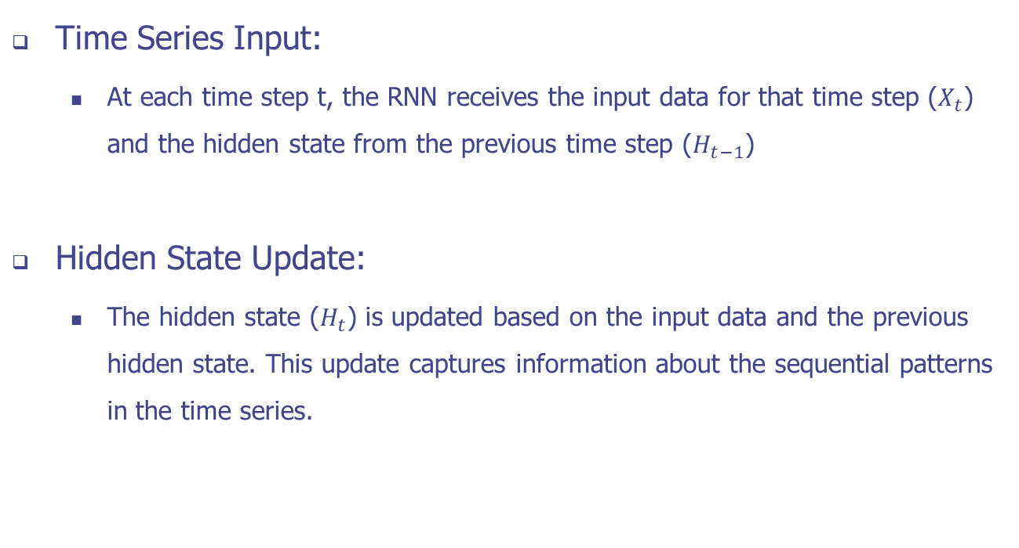
How RNNs can applied to time series data
Recurrent Neural Networks for time series
9
Notes:
9

Slide 10
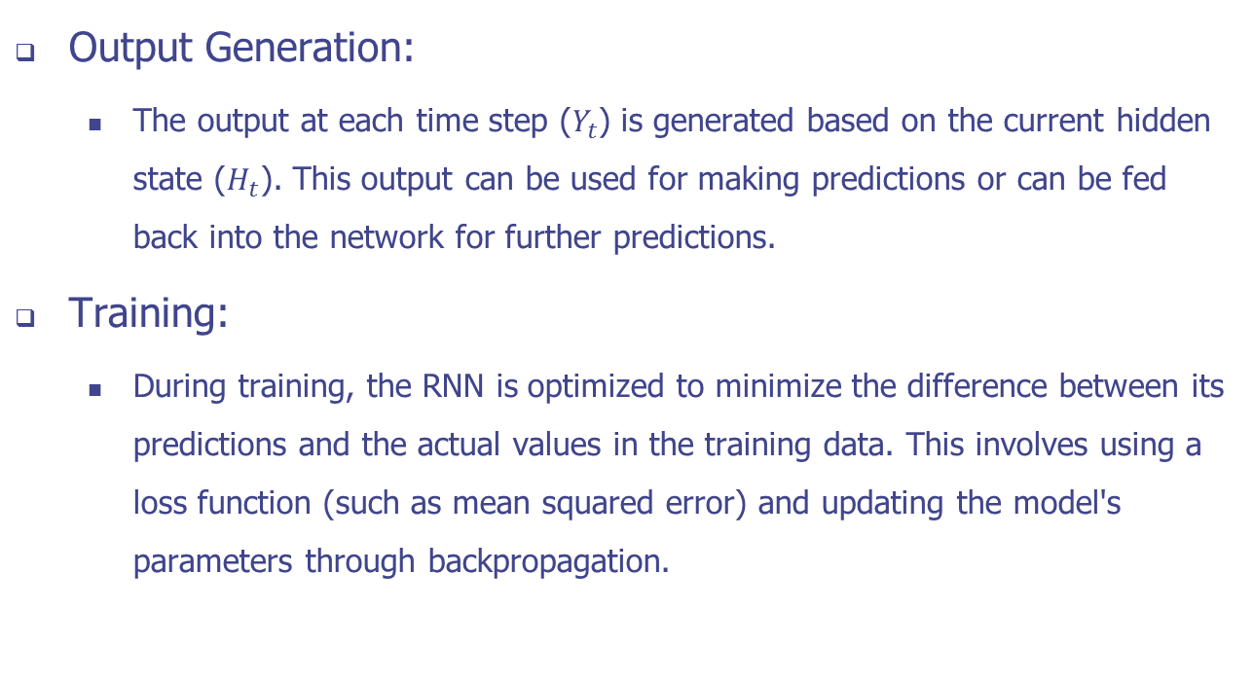
How RNNs can applied to time series data

Slide 11
How RNNs can applied to time series data
Backpropagation Through Time (BPTT):
RNNs use a variation of backpropagation called Backpropagation Through Time. This involves propagating the error gradients backward through the entire sequence to update the weights of the network.
Long Short-Term Memory (LSTM) and Gated Recurrent Unit (GRU):
To address the vanishing gradient problem and capture long-term dependencies, more advanced RNN architectures like LSTMs and GRUs are often used. These architectures introduce memory cells and gating mechanisms to better control the flow of information.
Recurrent Neural Networks for time series
11
Notes:
11

Slide 12
How RNNs can applied to time series data
Hyperparameter Tuning:
Experiment with hyperparameters such as the number of recurrent units, the learning rate, and the sequence length to find the configuration that works best for your specific time series data.
Validation and Testing:
After training, evaluate the model on a validation set to ensure it generalizes well. Then, test the model on an independent test set to assess its performance on unseen data.
Recurrent Neural Networks for time series
12
Notes:
12

Slide 13
Implement a Simple RNN for forecasting
Using Recurrent Neural Networks (RNNs) to build a forecasting model.
build a stacked RNN using simpleRNN layers
use Lambda layers to reshape the input and scale the output
use the Huber loss during training
use batched data windows to generate model predictions
Recurrent Neural Networks for time series
13
Notes:
13

Slide 14
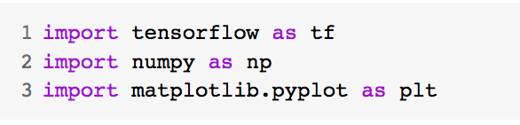
Implement a Simple RNN for forecasting
Imports libs
Tensorflow to build your model and prepare data windows
Numpy for numerical processing
Matplotlib's PyPlot library for visualization
Recurrent Neural Networks for time series
14
Notes:
14

Slide 15
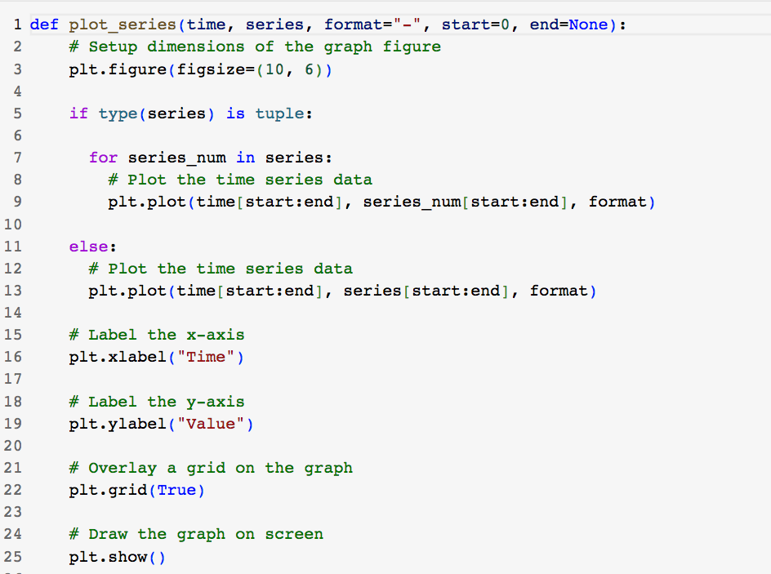
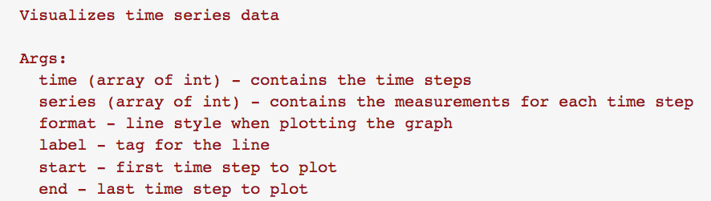
Implement a Simple RNN for forecasting
Utilities
Recurrent Neural Networks for time series
15
Notes:
15

Slide 16
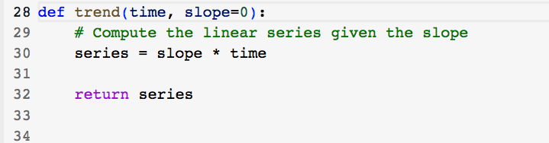
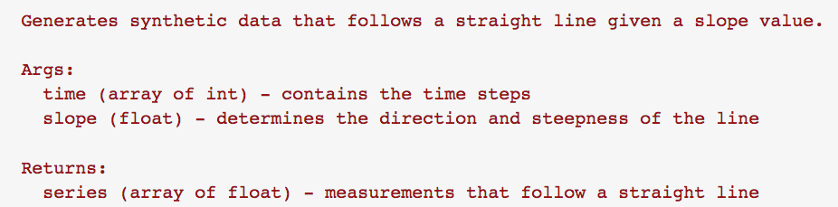
Implement a Simple RNN for forecasting
Utilities
Recurrent Neural Networks for time series
16
Notes:
16

Slide 17
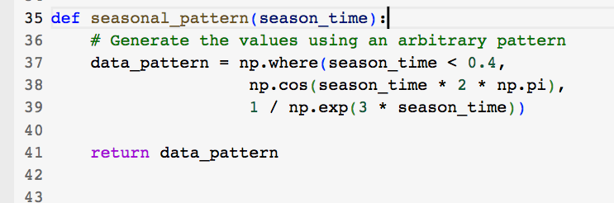
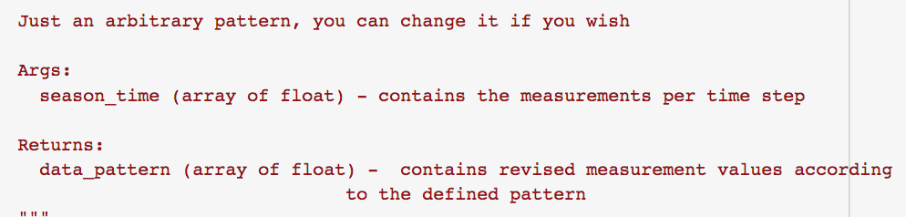
Implement a Simple RNN for forecasting
Utilities
Recurrent Neural Networks for time series
17
Notes:
17

Slide 18
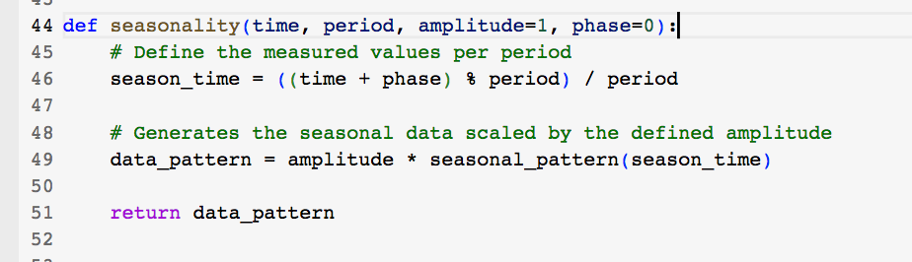
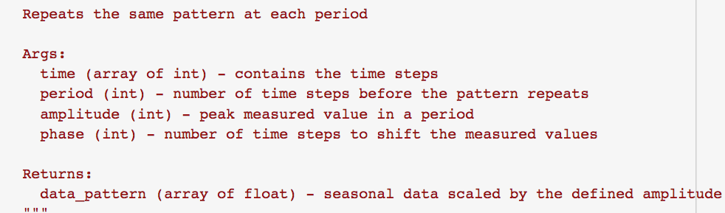
Implement a Simple RNN for forecasting
Utilities
Recurrent Neural Networks for time series
18
Notes:
18

Slide 19
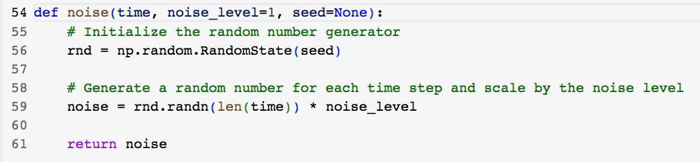
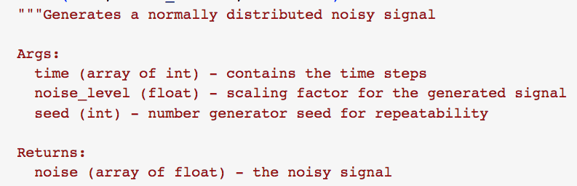
Implement a Simple RNN for forecasting
Utilities
Recurrent Neural Networks for time series
19
Notes:
19

Slide 20
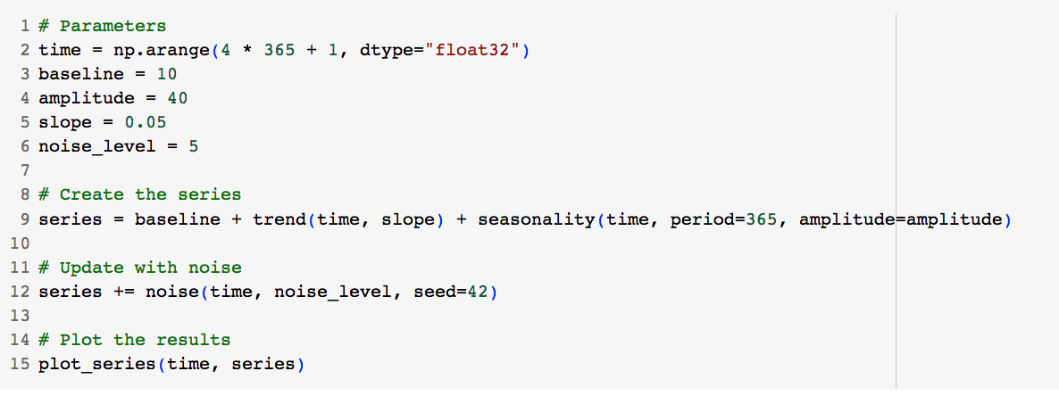
Implement a Simple RNN for forecasting
Generate the Synthetic Data
Recurrent Neural Networks for time series
20
Notes:
20

Slide 21
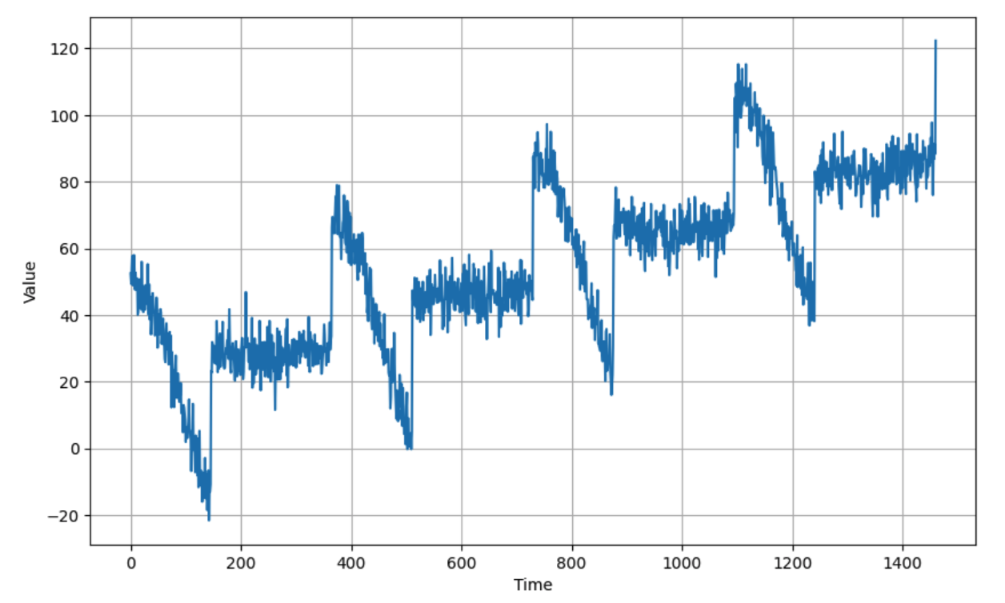
Implement a Simple RNN for forecasting
Generate the Synthetic Data
Recurrent Neural Networks for time series
21
Notes:
21

Slide 22
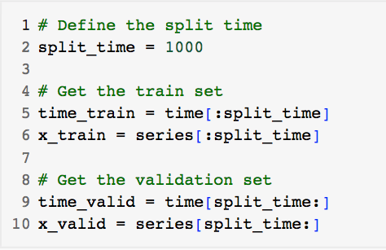
Implement a Simple RNN for forecasting
Split the Dataset
Recurrent Neural Networks for time series
22
Notes:
22

Slide 23
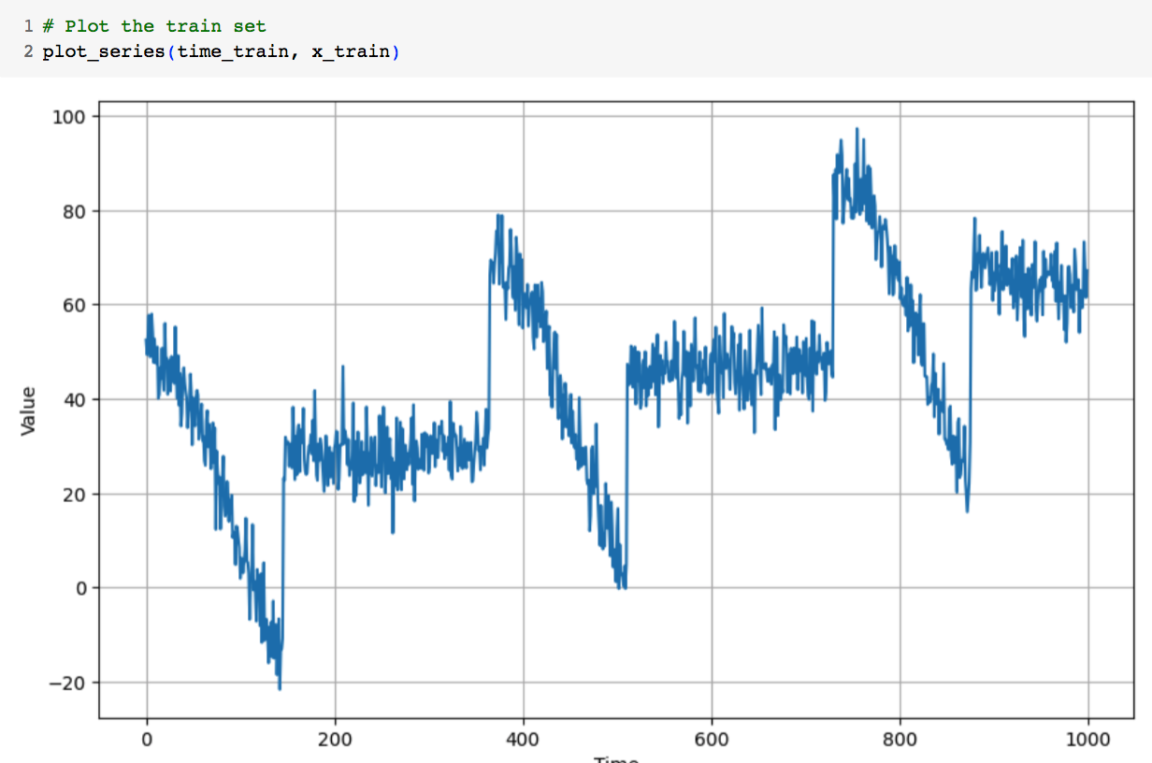
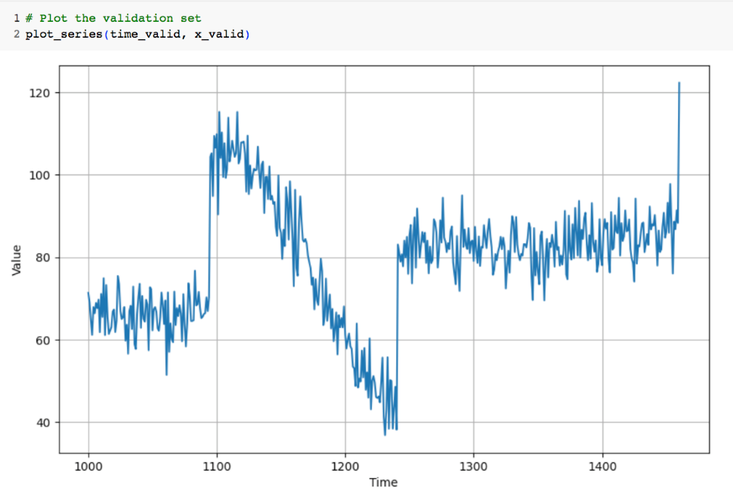
Implement a Simple RNN for forecasting
Train and validation set
Recurrent Neural Networks for time series
23
Notes:
23

Slide 24
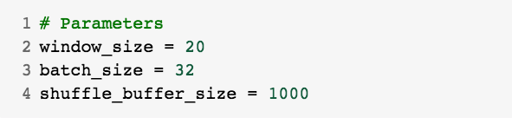
Implement a Simple RNN for forecasting
Prepare features and labels
Recurrent Neural Networks for time series
24
Notes:
24

Slide 25
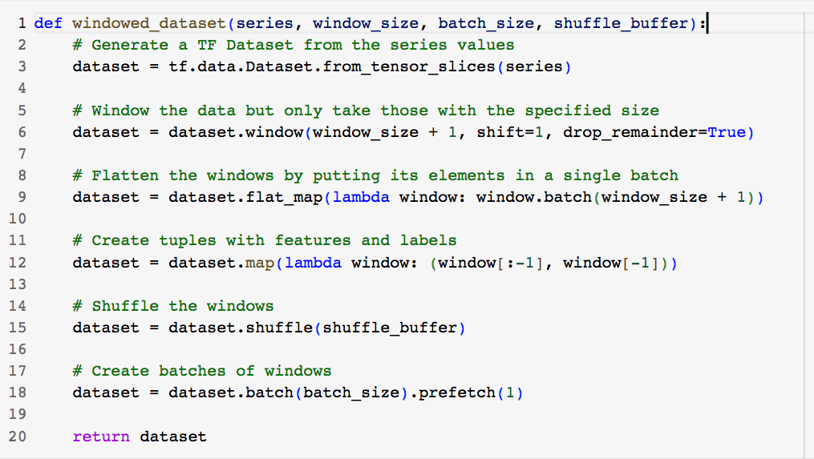
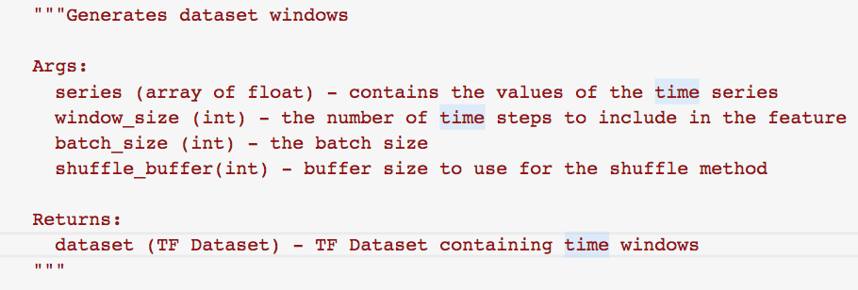
Implement a Simple RNN for forecasting
Generates dataset windows
Recurrent Neural Networks for time series
25
Notes:
25

Slide 26
Implement a Simple RNN for forecasting
Generate the dataset windows from the train set.
Recurrent Neural Networks for time series
26
Notes:
26

Slide 27
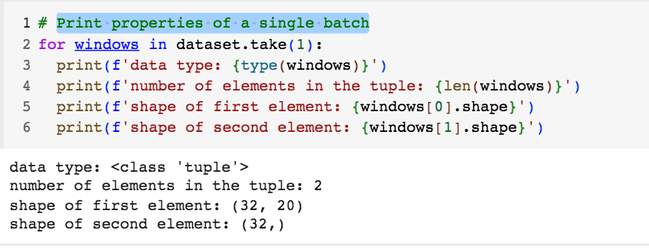
Implement a Simple RNN for forecasting
Print properties of a single batch
Recurrent Neural Networks for time series
27
Notes:
27

Slide 28
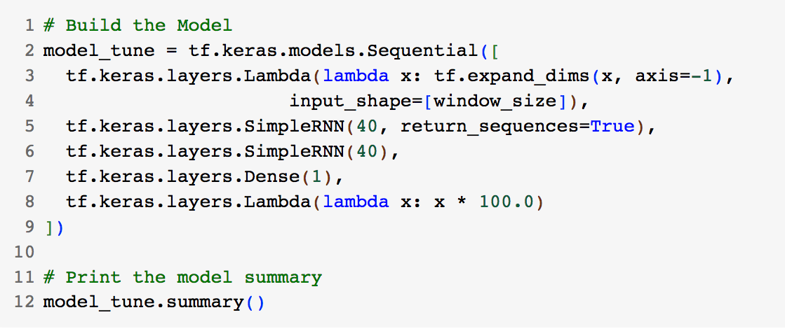
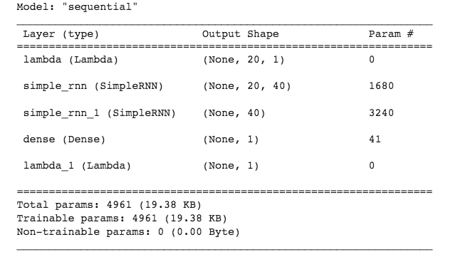
Implement a Simple RNN for forecasting
Build the Model
Recurrent Neural Networks for time series
28
Notes:
28

Slide 29
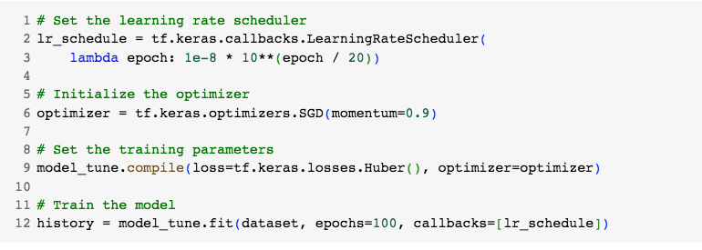
Implement a Simple RNN for forecasting
Tune the Learning Rate
Recurrent Neural Networks for time series
29
Notes:
29

Slide 30
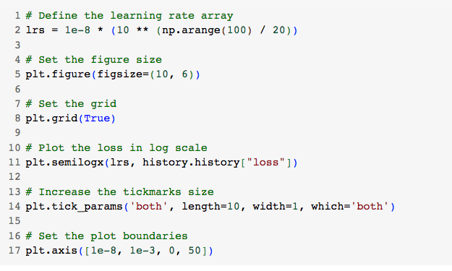
Implement a Simple RNN for forecasting
Visualize the results and pick an optimal learning rate.
Recurrent Neural Networks for time series
30
Notes:
30

Slide 31
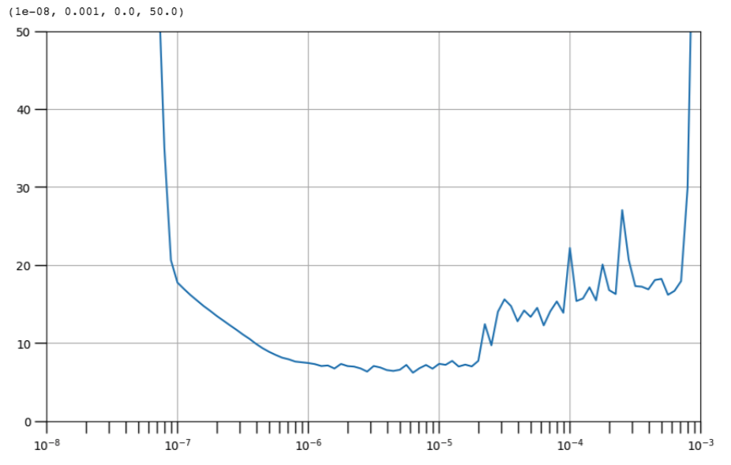
Implement a Simple RNN for forecasting
Visualize the results and pick an optimal learning rate.
Recurrent Neural Networks for time series
31
Notes:
31

Slide 32
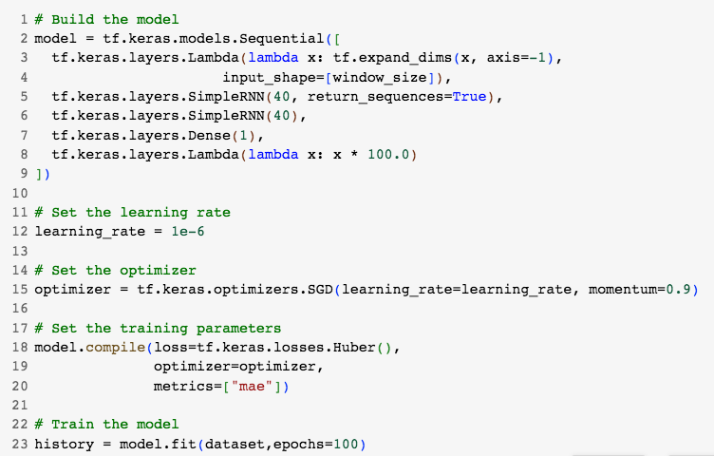
Implement a Simple RNN for forecasting
Declare the model again and train with the learning rate you picked.
Recurrent Neural Networks for time series
32
Notes:
32

Slide 33
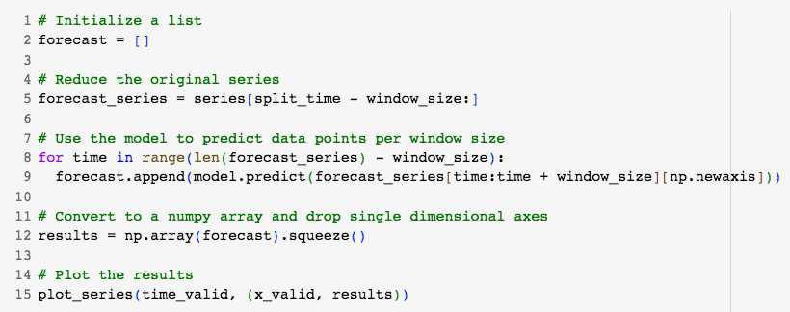
Implement a Simple RNN for forecasting
Model Prediction
Recurrent Neural Networks for time series
33
Notes:
33

Slide 34
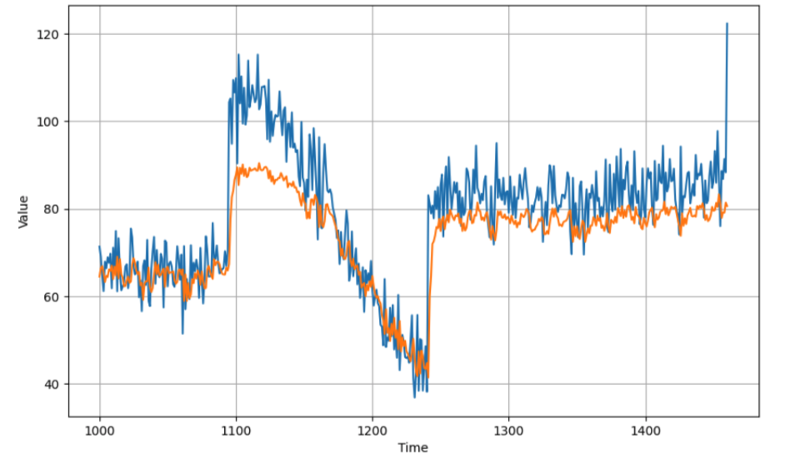
Implement a Simple RNN for forecasting
Model Prediction
Recurrent Neural Networks for time series
34
Notes:
34

Slide 35
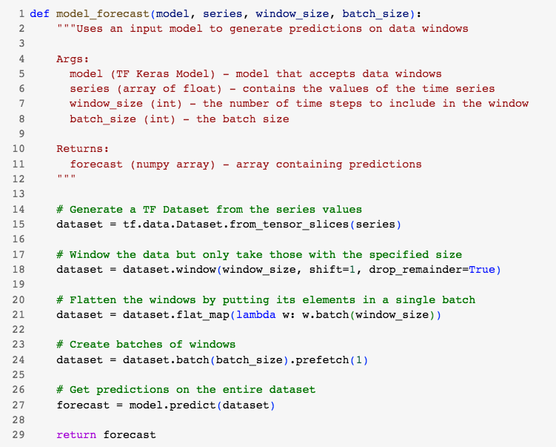
Implement a Simple RNN for forecasting
Leveraging Tensorflow models' capability to process batches
Recurrent Neural Networks for time series
35
Notes:
35

Slide 36
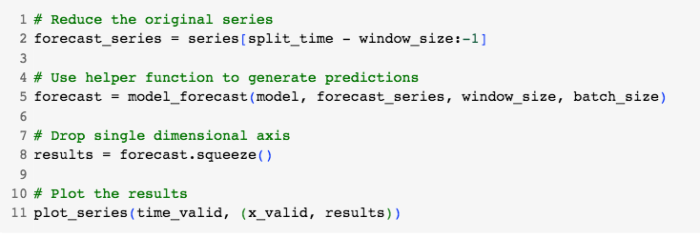
Implement a Simple RNN for forecasting
Results
Recurrent Neural Networks for time series
36
Notes:
36

Slide 37
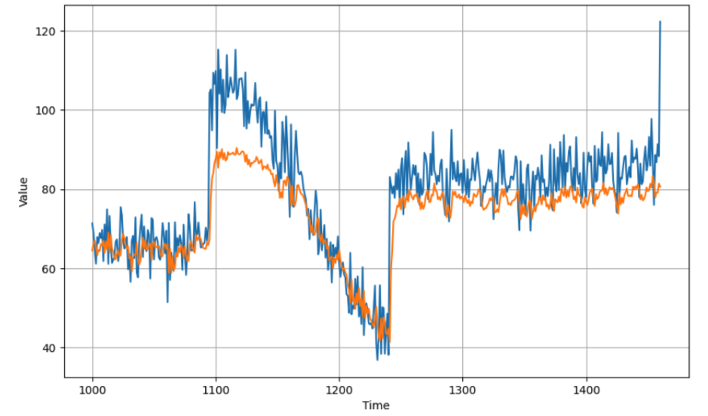
Implement a Simple RNN for forecasting
Results
Recurrent Neural Networks for time series
37
Notes:
37

Slide 38
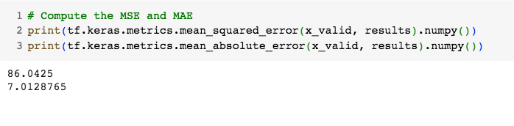
Implement a Simple RNN for forecasting
Compute the MSE and MAE.
Recurrent Neural Networks for time series
38
Notes:
38

Slide 39
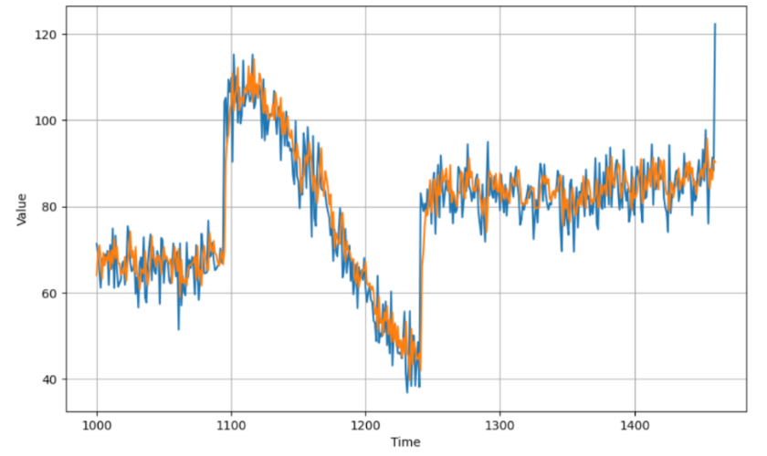
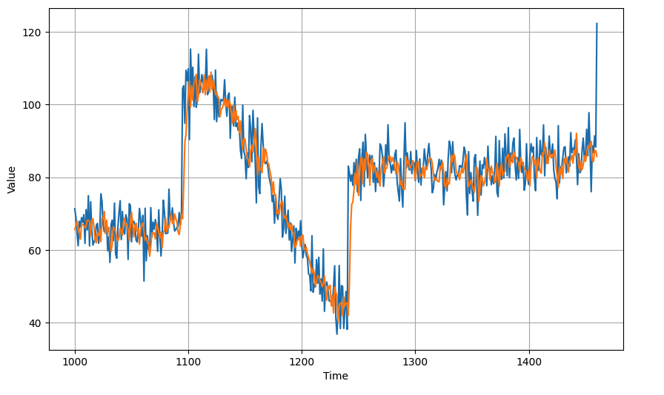
Student discuss and give opinions
SNN
DNN
RNN
Recurrent Neural Networks for time series
39
Notes:
39

Slide 40
Summary
Conceptual overview Recurrent Neural Networks for time series
Implement a Simple RNN for forecasting
Recurrent Neural Networks for time series
40

Slide 41
Q & A
Recurrent Neural Networks for time series
41

